Slide 1

Group Name:
Q & L
Web and app development

Slide 2


Client:
APPLY PRESSURE
SHOE CLEANERS AND MORE

Slide 3
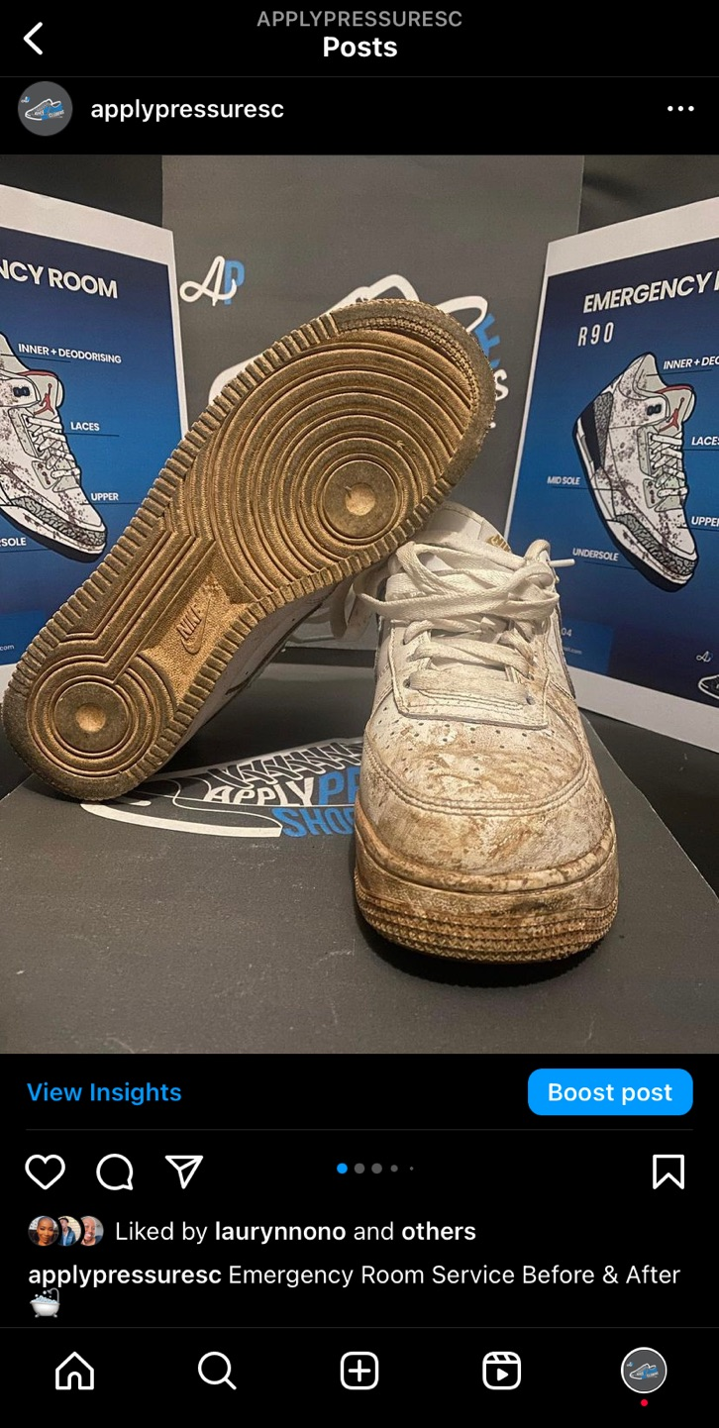
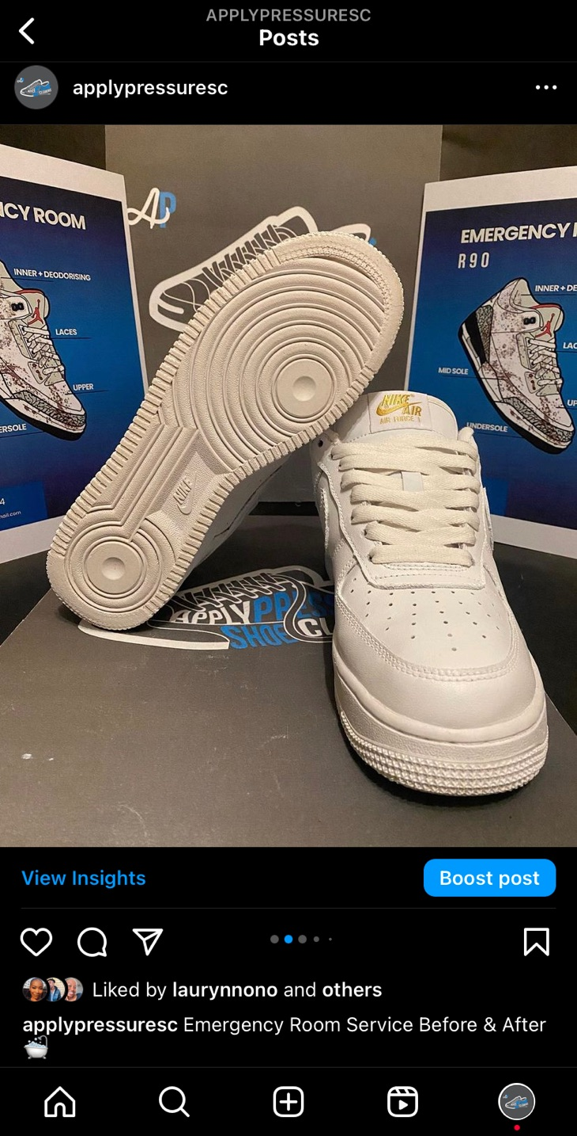
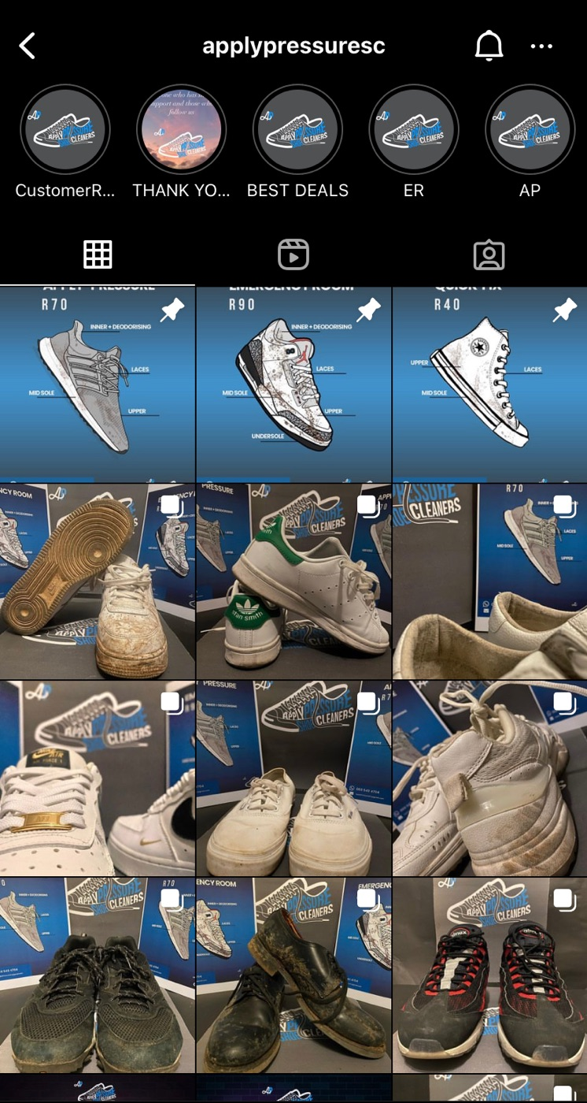

Slide 4

The Problem Domain
The traditional laundry service industry often relies on in-person or phone-based bookings, which can be time-consuming and inconvenient for customers. By digitizing the process, we aim to provide a seamless experience for customers to book and pay for laundry services online, as well as offer a collection and delivery service through a single app.

Slide 5

Business solution
⦁ Provide a convenient and user-friendly platform for customers to book and pay for laundry services online.
⦁ Modernize the collection and delivery process to enhance customer satisfaction and operational efficiency.
⦁ Enable laundry service providers to expand their customer reach and improve business visibility.

Slide 6
THANK YOU

